Slide 1


Slide 2
Smart Water Management System: IoT-Based Tank Monitoring and Pump Automation

Slide 3
INTRODUCTION OF PROJECT
The Smart Water Management System (SWMS) is an innovative and user-friendly solution designed to optimize water usage and provide peace of mind for homeowners. This system utilizes a network of sensors and a mobile app to monitor water levels, automate pump operation, and eliminate the need for manual intervention.

Slide 4
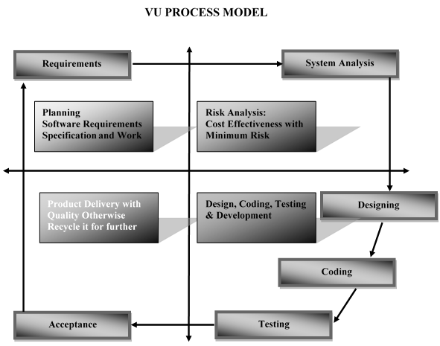
Process Model.

Slide 5
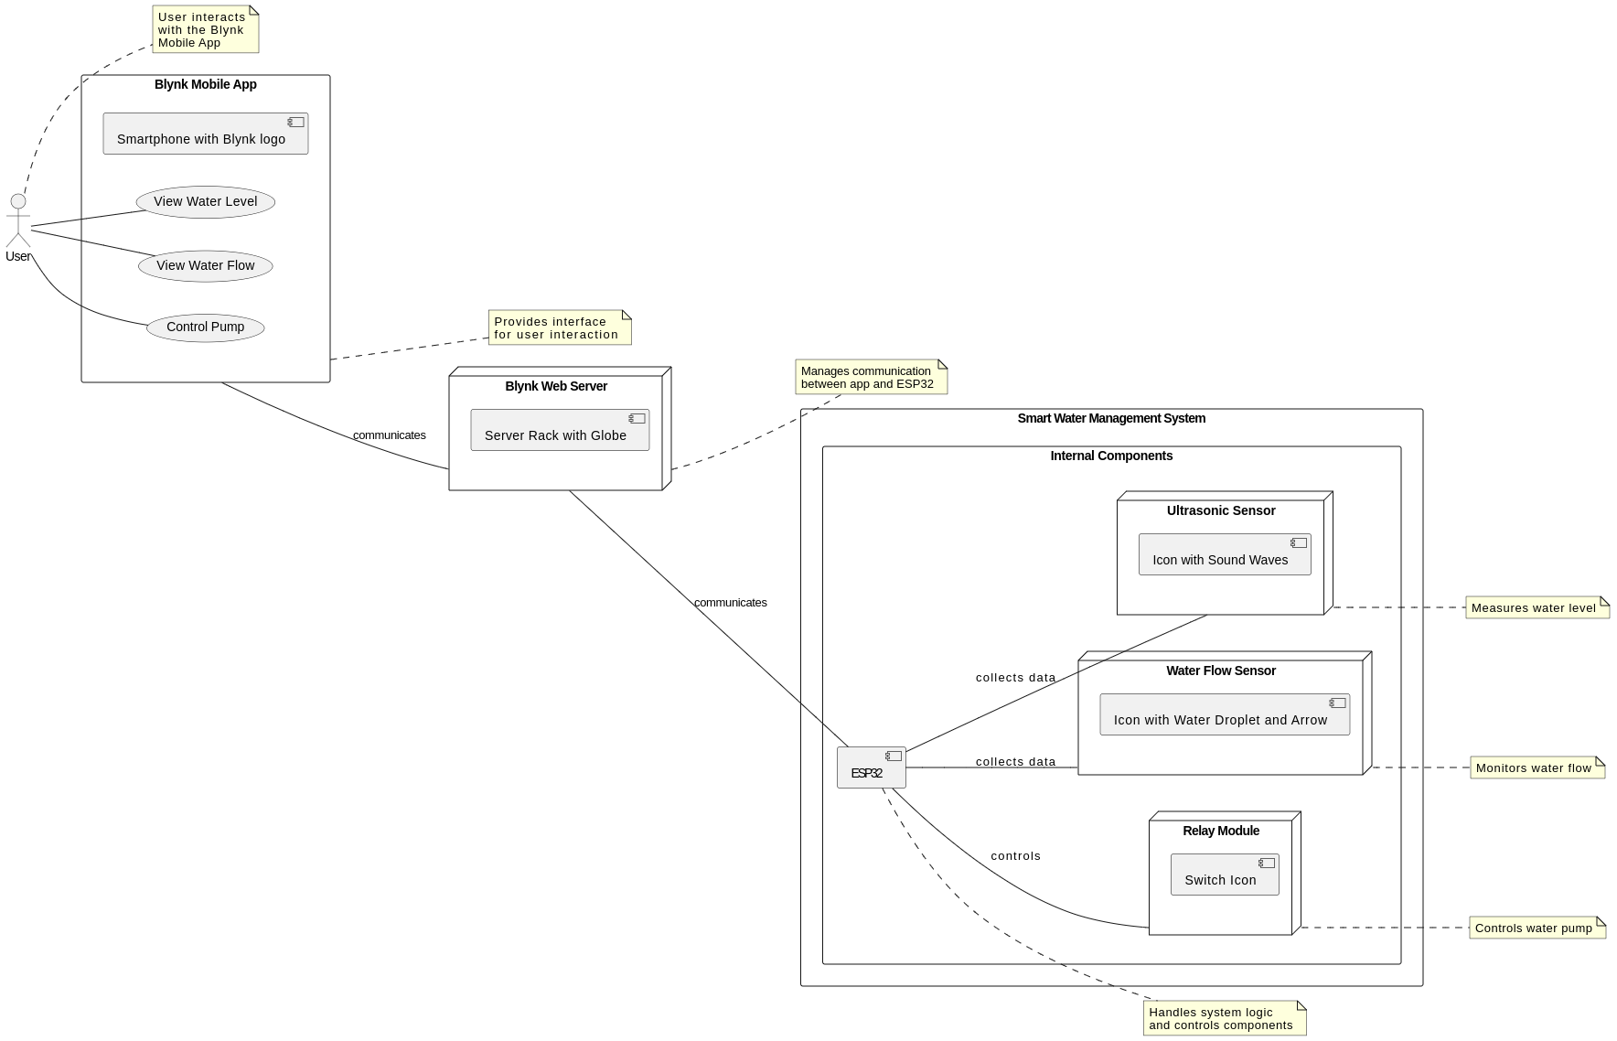
Use Case Diagram

Slide 6
Business Rules Catalog
· The automated system will have the following functional requirements:
· Continuously monitor the water level in the roof tank using an ultrasonic sensor.
· Automatically start the water pump when the water level falls below a predefined threshold in the roof tank.
· Monitor water flow in the pipe using a water flow sensor and stop the pump when there is no water flow (indicating that the ground tank is empty).
· Automatically stop the water pump when the water level rises above a predefined threshold to prevent water overflow.

Slide 7
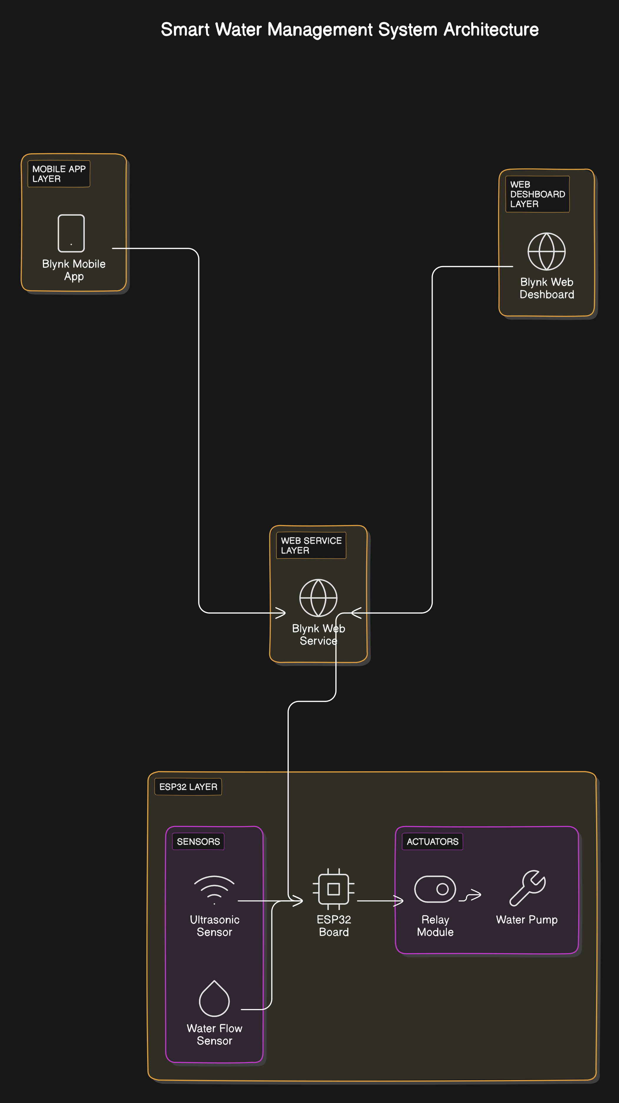
Architectural Design

Slide 8
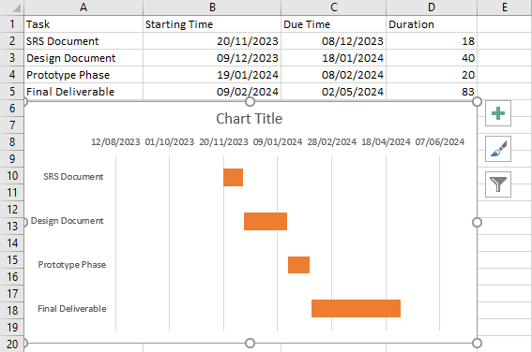
Project Schedule

Slide 9
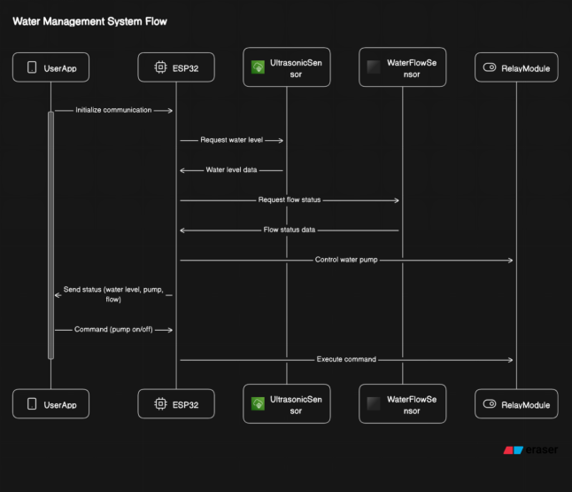
Sequence Diagrams

Slide 10
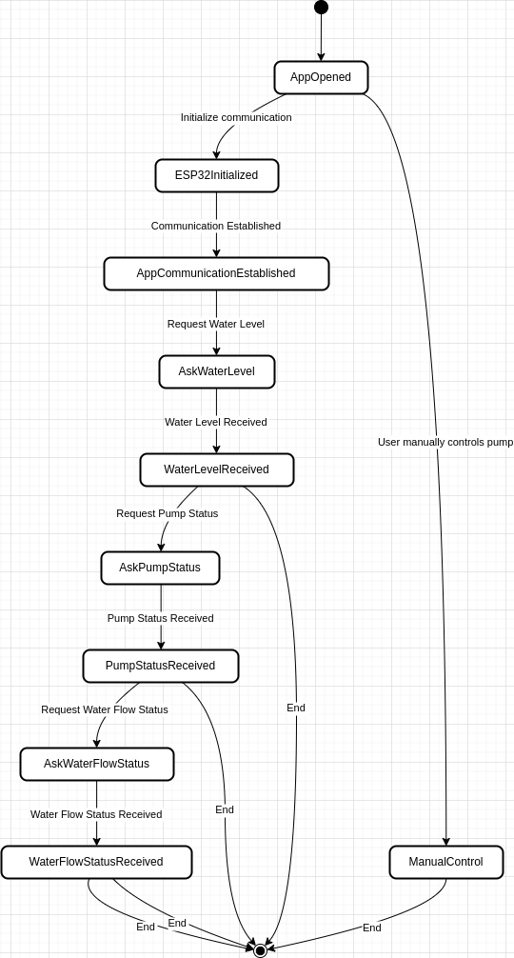
System State Machine Diagram

Slide 11
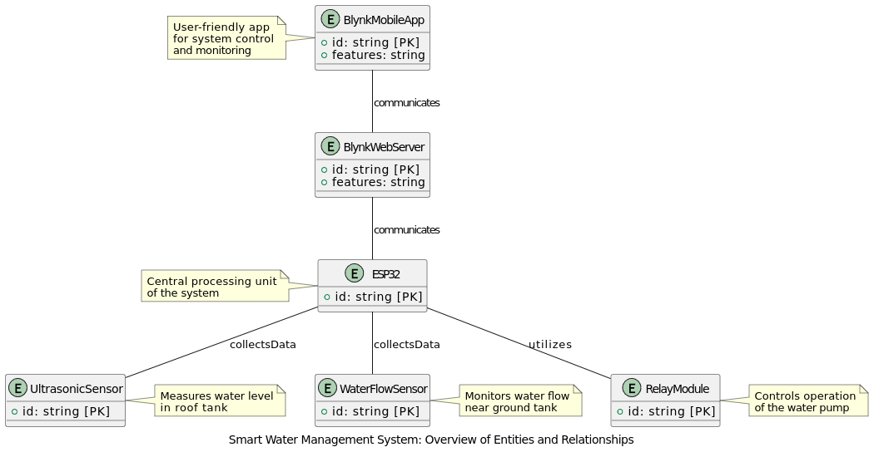
Entity-Relationship Diagram

Slide 12
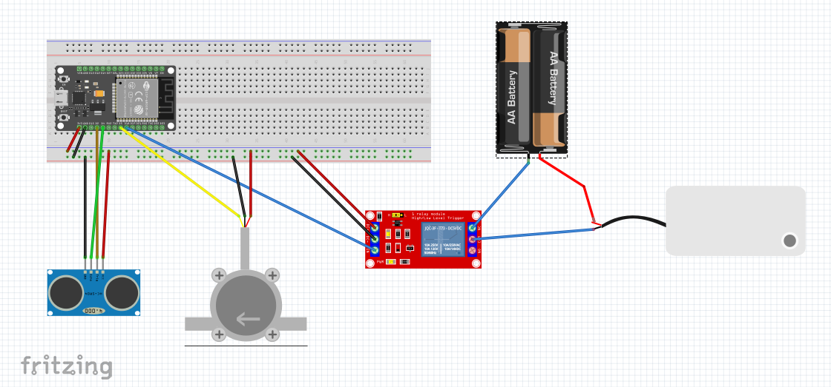
Circuit Diagram

Slide 13
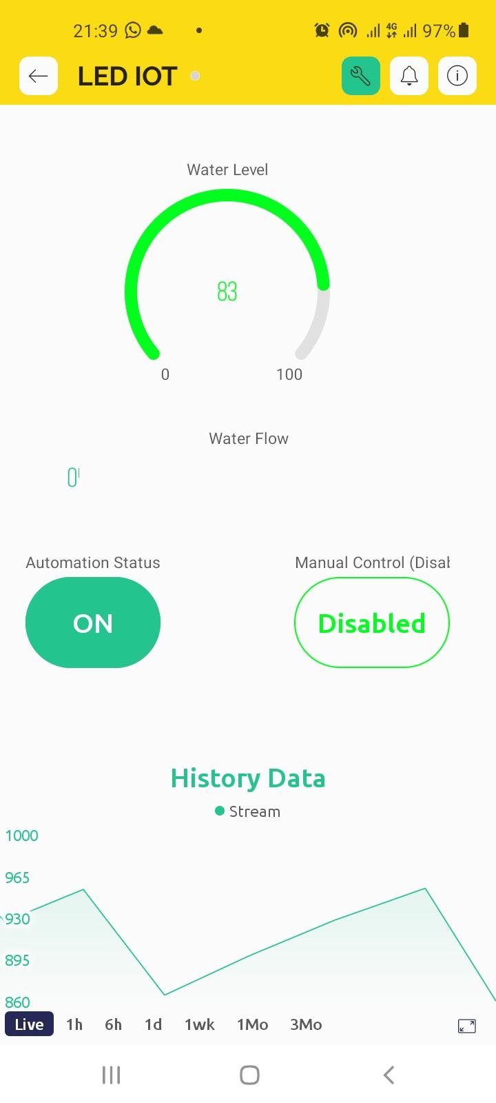
User Interfaces

Slide 14
Tools
Potential Tools Used:
Hardware Development:
Microcontrollers (e.g., Arduino, ESP32): For collecting sensor data and controlling actuators.
Sensors (e.g., ultrasonic, flow rate): To measure water level and flow.
Actuators (e.g., solenoid valves,Relay moduel): To control water flow.
Breadboards and jumper wires: For prototyping circuits.
Multimeter: For testing electrical connections.
Soldering iron (optional): For building permanent circuits.
Software Development:
Integrated Development Environment (IDE) (e.g., Arduino IDE, Visual Studio Code): For writing, compiling, and uploading code to the microcontroller.
Programming Language (e.g., C++, Arduino C): For programming the microcontroller.
IoT Platform (e.g., Blynk, ThingSpeak): For data visualization, remote control, and automation.
Version Control System (e.g., Git): For managing code changes and collaboration (if applicable).
Testing and Debugging:
Serial Monitor: To view sensor readings and debug code.

